Slide 1

EMOTIONAL GROWTH

Slide 2


Slide 4


Slide 6

ANGER

Slide 7

P E A C E

Slide 8
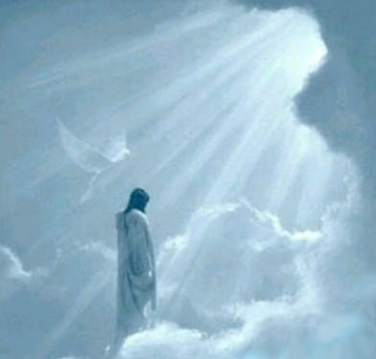
Let the light of The Almighty
spread to the entire Earth
giving it life and a purpose.

